Slide 1
Book1
File created on: 2/27/26 5:15:25 PM GMT+8

Slide 2
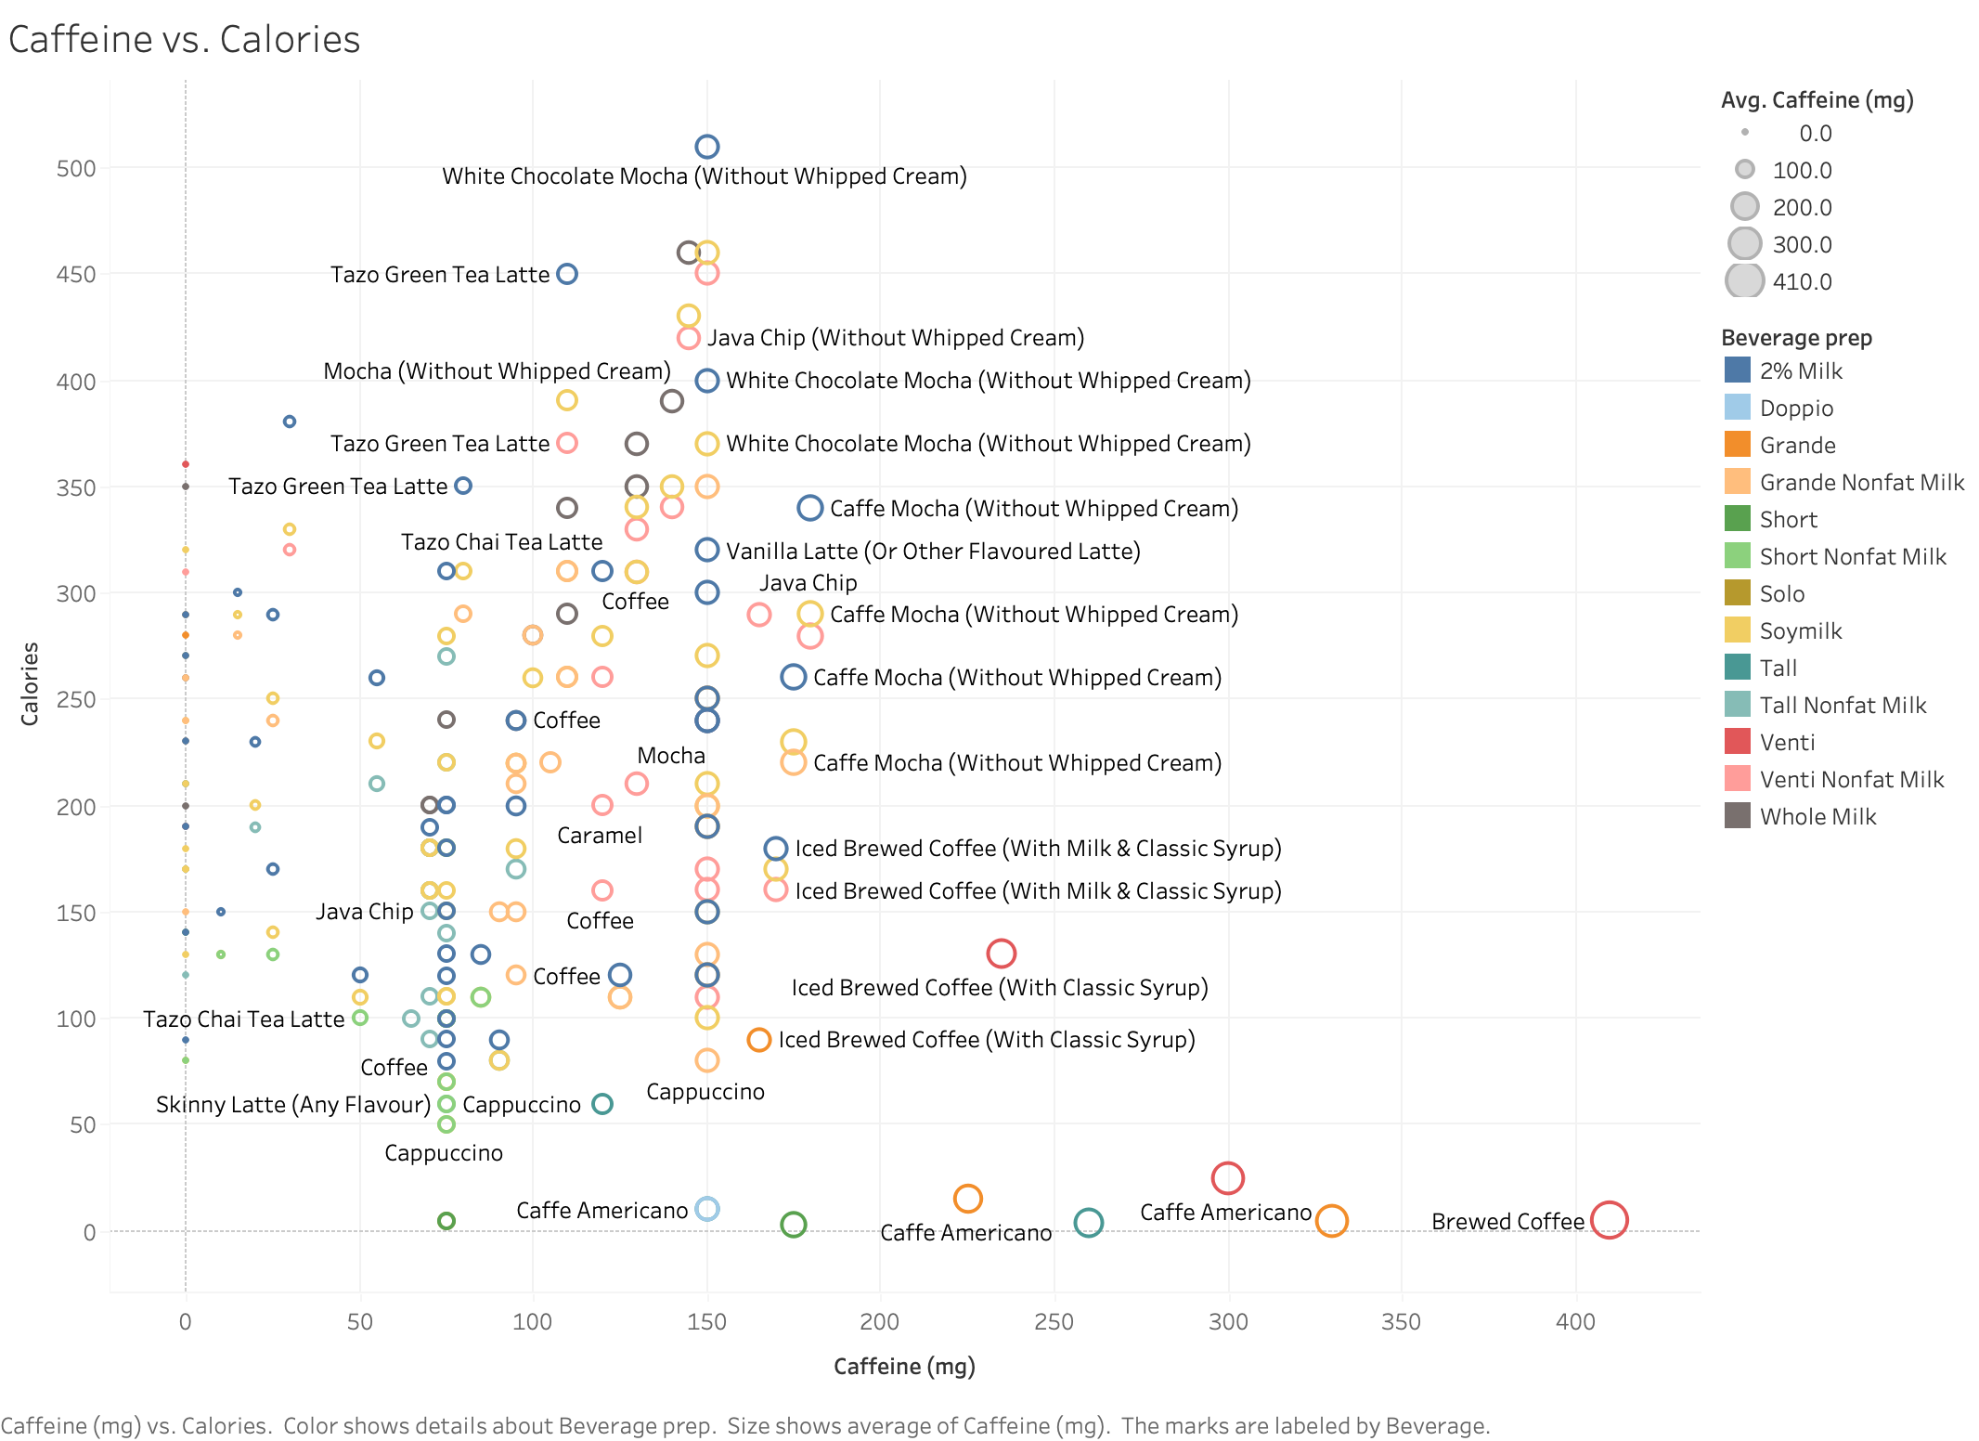

Slide 3
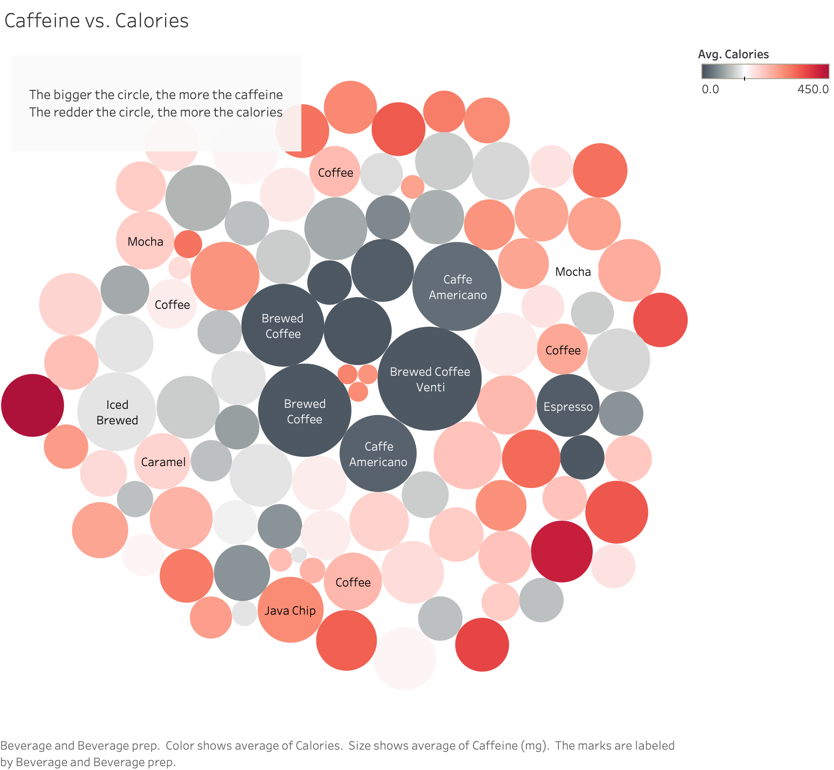

Slide 4
